Slide 1
Green Engine
PRESENTED BY
Name: Mahesh.M,
Pin No: 17L65A0321,
Branch: Mechanical Engineering

Slide 2
Contents
Introduction
Need for Invention
What Green Engine Can Do
Technical features of Green Engine
Construction Working
Advantages of Green Engine
Applications
Conclusion

Slide 3
Introduction
A Green engine is any “power source” or “Engine” from which the fuel or energy source is a green resource or zero emission energy source such as wind, solar or wave energy.
Green Engine is the internal combustion engine with some or major modifications in its parts and design.
The green engine is one of the most interesting discoveries of the new millennium.
The efficiency of this engine is high when compared to the contemporary engines and also exhaust emissions are near zero.

Slide 4
Need for Invention
Today world is facing the major problems regarding energy crisis .
Along with this we’re facing major environmental trouble due to increase in harmful gases which are evolved from nowhere else but the combustion of these conventional energy sources.
Pollution is minimized by the Green Engine.
Statistics shows that the daily consumption of petroleum all over the world today is 40 million barrels, of each about 50% is for automobile use.

Slide 5
What Green Engine Can Do
To reduce the environmental hazards, only way is to use energy in the way it will not harm the environment.
Green engine is an actual six phase internal combustion engine with much higher expansion ratio, low exhaust emission, high efficiency and low vibrations.
The significance of the engine lies in the efficiency when the present world conditions of limited resources of energy are considered.
It’s uniqueness to adopt any fuel which is also well burnt.

Slide 6
Technical features of Green Engine
It has six independent or separate working processes:
>> Intake, Compression, Mixing, Combustion, Power and Exhaust,
resulting in the high air charge rate. Satisfactory air-fuel mixing, complete burning, high combustion efficiency and full expansion.
The most important characteristic is the expansion ratio being much bigger than the compression ratio.
Also, the other main features are the revolutionary innovations of the sequential variable compression ratio, constant volume combustion and self-adapting sealing system.
Therefore, an engine having extremely high thermal efficiency, near-zero emissions, quietness, light and small, lower cost with capability of burning of various fuels has come into being.

Slide 7
“Construction” & Working
It consists of a set of vanes, a pair of rotor’s which houses a number of small pot like containers.
It contains of two air intake ports, a pair of fuel injectors and spark plugs.
This spark plug can deactivated when a fuel doesn’t need sparks .
The rotor is made high heat resistance and low expansion rate materials such as ceramic.
The vanes are consists in two way parts.

Slide 8
Construction & “Working”
As earlier mentioned, the Green engine is a six phase, internal combustion engine with much higher expansion ratio.
The term "phase" is used instead of "stroke" because stroke is actually associated to the movement of the piston.
The traveling of the piston from bottom dead center to the top dead center or vice versa is termed a stroke.
But, in this engine pistons are absent and hence, the term "phase" is used. The six phases are: intake, compression, mixing, combustion, power and exhaust.

Slide 9
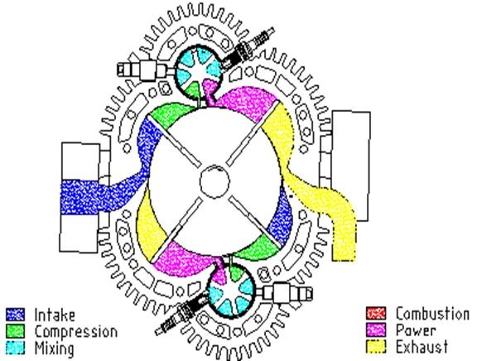
Working model

Slide 10
Advantages of Green Engine
As obvious from the technical features which include effective innovations, the advantages of the Green engine over the contemporary piston engines are many.
Small Size and Light Weight
Limited Parts
High Efficiency
Multi-fuels
Near-zero Emissions
Smooth Operation
Fast Accelerating Response
Quietness and Low Exhaust Temperature

Slide 11
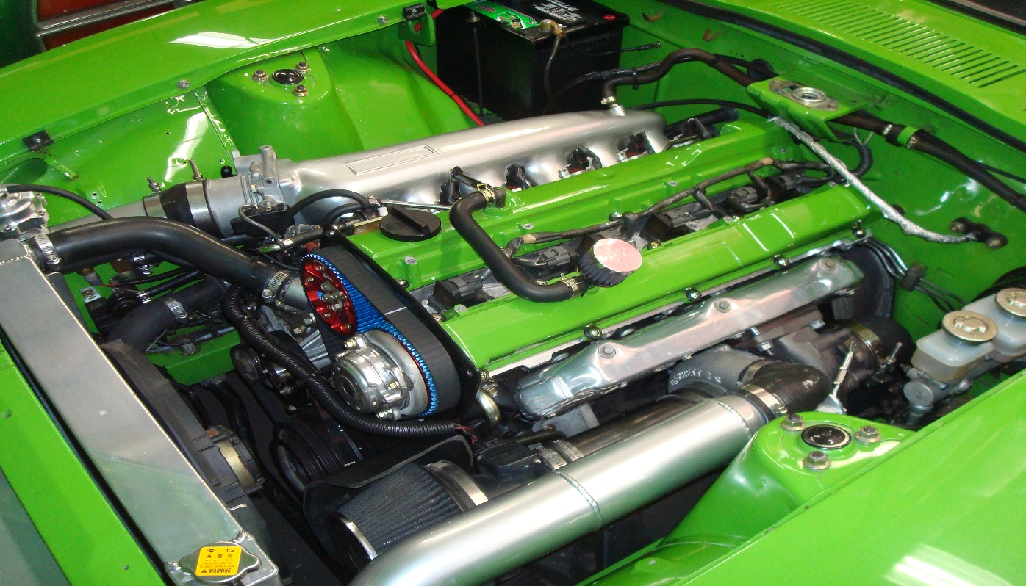
Applications
Like normal engine green engine can be employed in automobiles and in aircrafts too.
Engineering applications.
Military use.
Electrical Generators.
Ships and Submarines.

Slide 12
Conclusion
The Green engine’s prototypes have been recently developed, and also because of the unique design, limitations have not been determined to any extent.
But even in the face of limitations if any, the Green engine is sure to serve the purpose to a large extent

